Slide 1
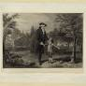
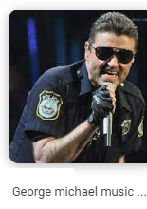
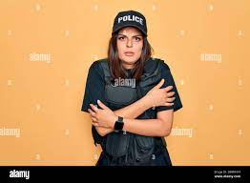

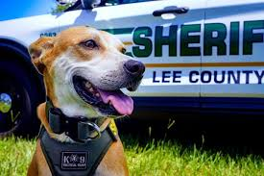
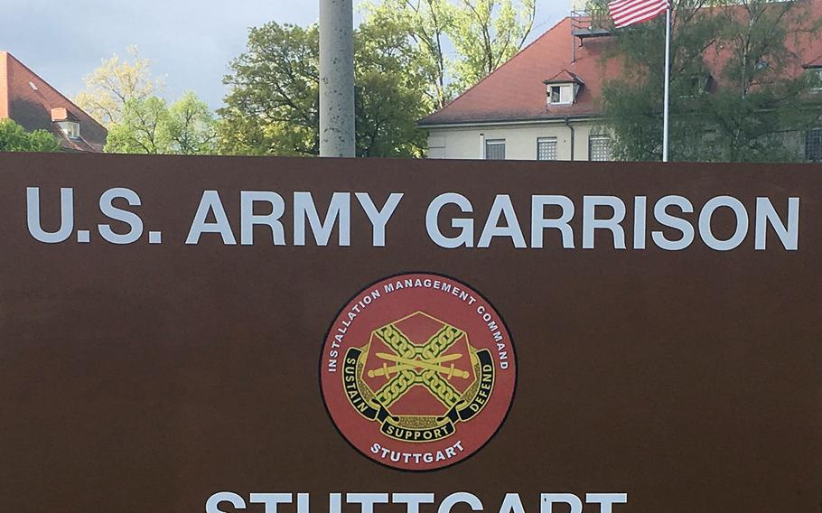
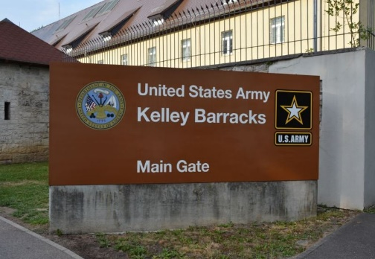
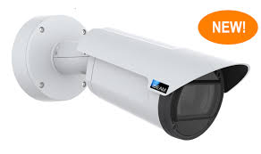
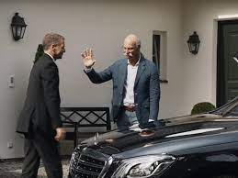
FBI
Development
W. 1st Street
8:00PM nonPoliceBlueprint FORT WORTH LIBRARY
§Stalking Rain black peron has raincoat – nonPoliceConvertLogical.x/y.FORT WORTH LIBRARY person has somehgint
!LIE 11/24/2023
GARRISON
KELLEY
VIRGIN.MARY
FORT WOTH LIBRARY(OFFSITE)
7:45
police fort myers officer chance
MILITARY
ID:US:CA:1986/7
And mother 0.31 not paly video game anymore
1994 WWI.BILL
nonPolcieLanguage.ingusti( as I was fuking this girl) nonPOlcieAudine Crhis, Joel, LarryLgoical and other)
WWI.PENGONA.BASE.bmw.NAVY BLUE girl( K_TOWN).WWI
7:00AM MLK.nonPoliceSTudl.development
14,15,16,17Logical
10 1991 VIRGINA MARY
1986 black Foser City Eelemtary School
1984 jenny Santa Cruz, Felton ,Zyante, Calfinro
Consent.FORT WORTH LIBARY
0.1 And playing video games
0:30
WAR IN YUGLAVIA
HOMICE:SUNSTOKE
1991(Kodak, phil/kim(tonsek), PAUL botchech, ELKE, steve, yuslavia)
Ice creame
x
Age 7
ScrollerLogical: 14
Age 14
Age 4
Friction(stop

Slide 2
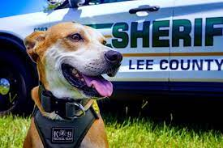
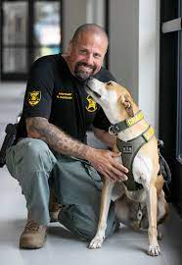
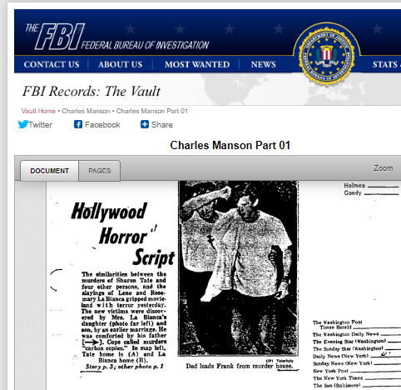
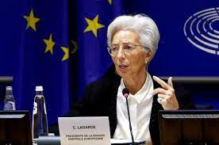
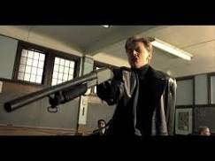
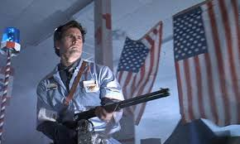
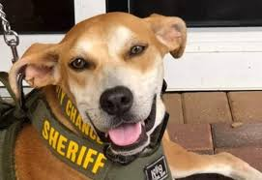
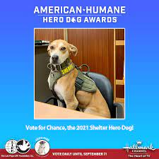
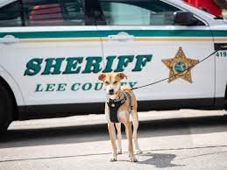
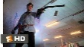

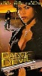

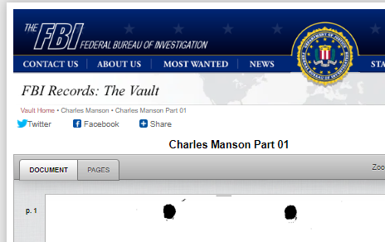
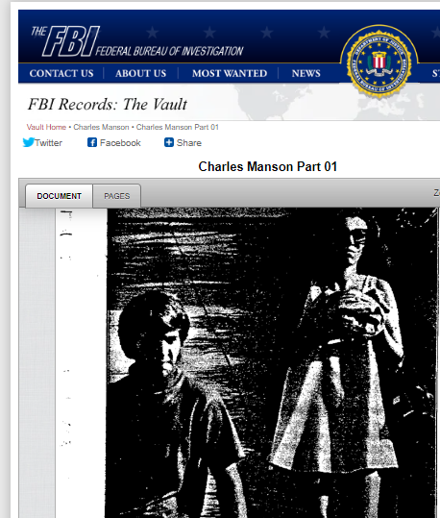
FBI
Development
W. 1st Street
SQ.ID:US:CA:SV.marx(yahoo)
!PREA.§187
FBIW:WMD:WW2:FOR OFFICE
Braun, EUROPEAN BANK CHEIF
Mayer, Marrissa
https://finance.yahoo.com/news/abused-abandoned-hero-dog-named-150155880.html
Abused and Abandoned, Hero Dog Named Deputy Chance Now Fights Against Animal Cruelty
For School IPX
Daniel
Face of dealth
Dace with devil, many devisl replocated in soul
army of darknes store cleak
Sound 0.1
HOCME:LUX:VHS
CHECKPONT CAHRLIE(angela, store ales cleak shotgun)
NORTAML TRX MISSIONARY with HEART NORMA TRA
0.59S for nonPolcieRTA.avg.nonPOlcieTRA&compare
Gensis
Chart
Chart
Man(ic)
0:15
0:15
!man(ic)
nonPoliceSounds( as a I not fuckign this girl §Publin Disbuace)

Slide 3
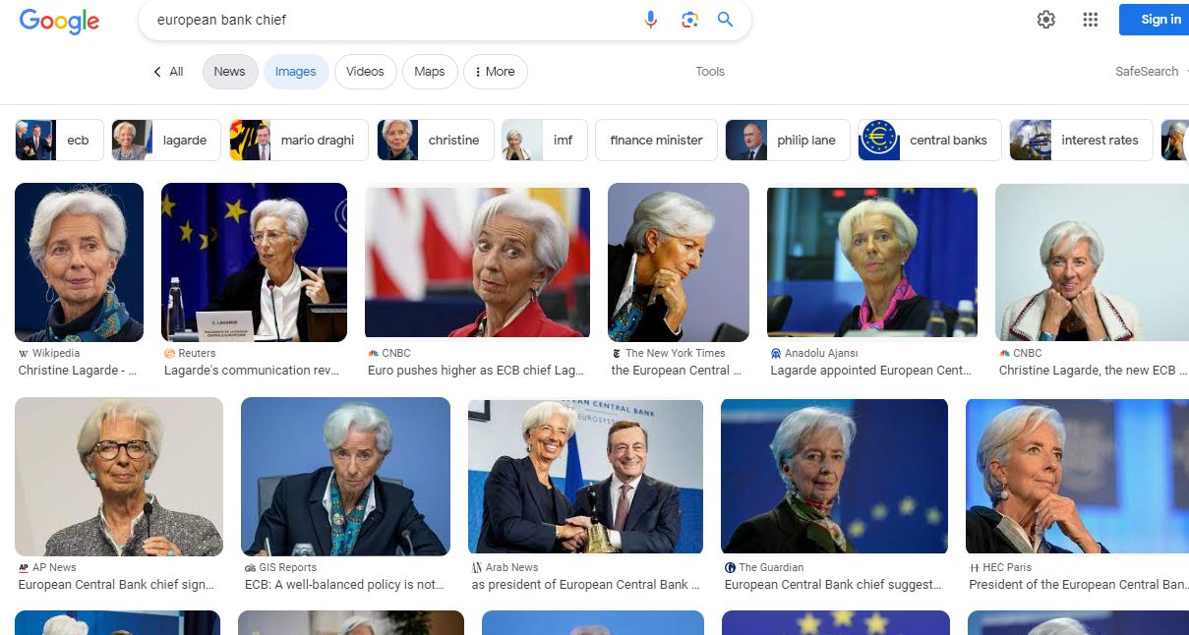
FBI
Development
Sandy Hook.avg.PROF
eval
roth
Visa.HERMAN (tnral) uncle fucker
GOD(MAN)
Shotoign everyton logcallgy 2011/14
Cybserouce.visa termantor eyes
Shotoign everyton logcallgy 2011/14

Slide 4
FBI
Development
0:01
!VIGINA.MARY
NORTAML TRX MISSIONARY with HEART NORMA TRA
0.59S for nonPolcieRTA.avg.nonPOlcieTRA&compare
Chart
0:15
!man(ic)
nonPoliceSounds( as a I not fuckign this girl §Publin Disbuace)

Slide 5
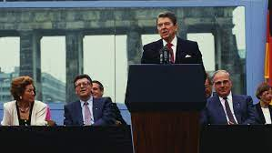
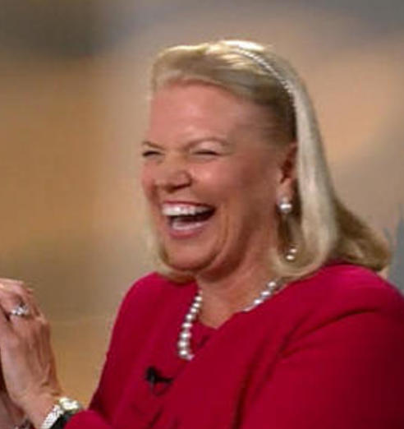
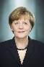
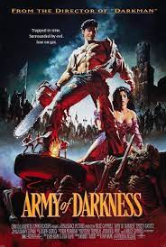

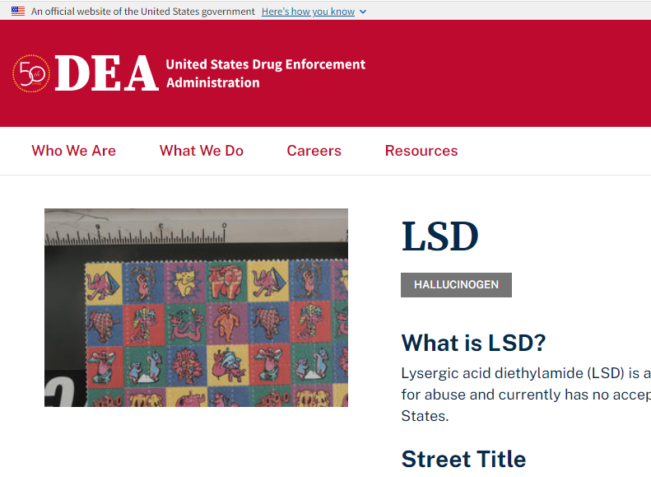
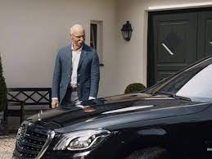
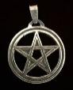
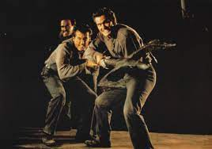
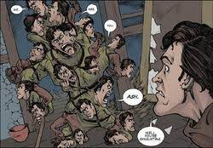
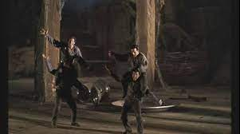
FBI
Development
Physophrania
VIRIGNIA
nonPoliceVoices.nonPolcieInti
idiot
Bank of America
Marla (PAUL)
PAUL
Free at last
DEA(lsd)
Physophrania
army of darnes souls evil small mini ashes
nonPoclieTrigger.x/y
0.1 fine nonPoceSoundLogical
x
GARRISON & KELLEY
Free at last
POLCIE SIRNES: 8:48PM
Physophrania

Slide 6
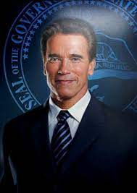
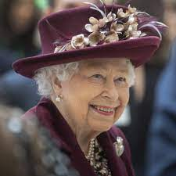

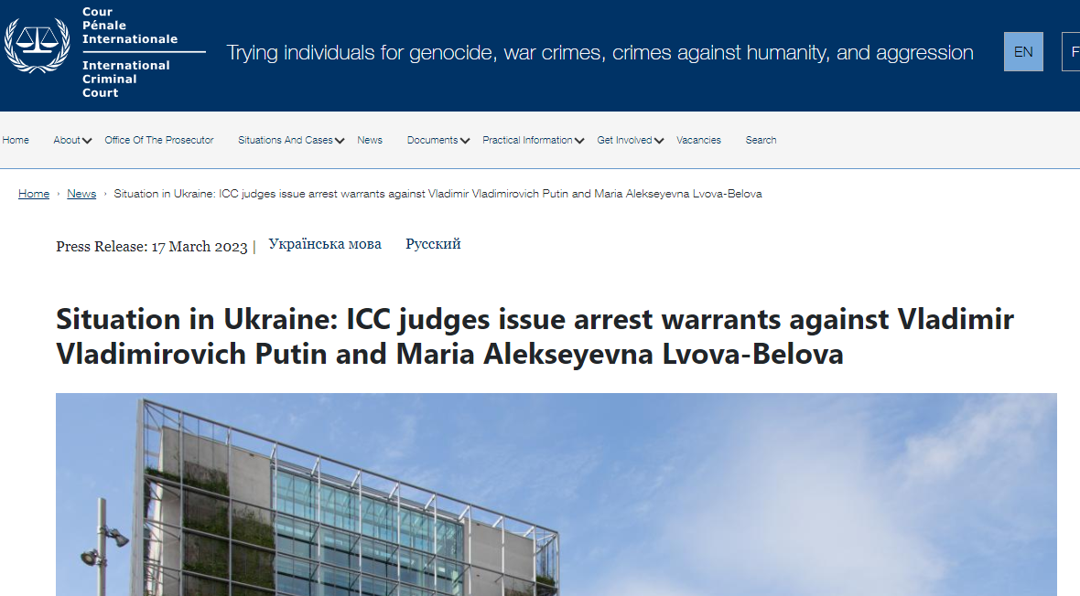
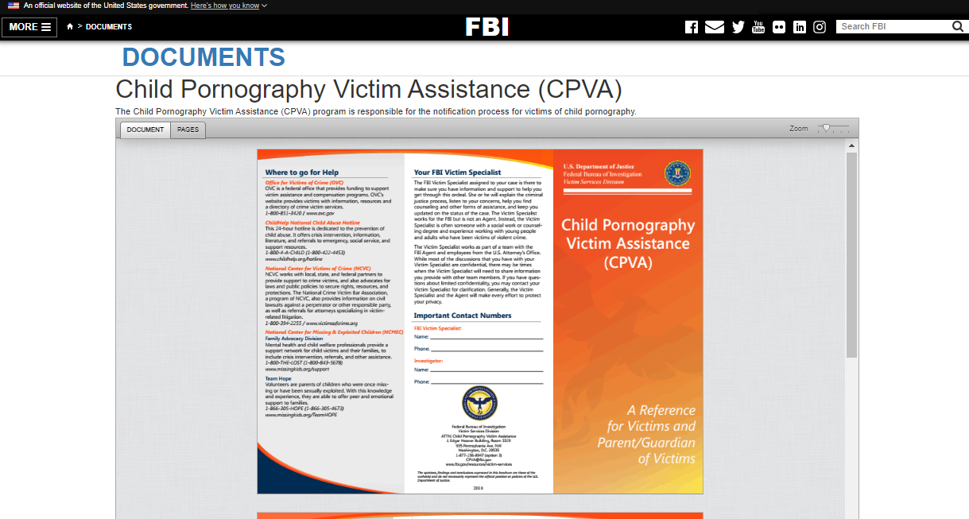
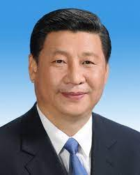
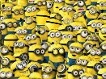



FBI
Development
IBM:NYSE
Situation Room
CNN: Internship, Miami
JFK(DEA(mdma).daneil and densie))
daniel sweden price gov
CPVA.VIRGIN.MARY(daniel and denise)
DANIEL
docs
WWI.Garden Store
1997/2013
Gov Schw.Garden Store
2000/1
PAUL
FEDERL DEFAULT
x
IPX
PREIST
!HOCME:GHOST;CONSULTATN
ATOMCLOCK(0.1 soul car, red)
0.1 eval.EVIL.telsa.&.ext
CPVA.nonPolcieAttment.MLITARY.PENGON.emea(attments)
SQ.ID:US:CA:SV.marx(yahoo)
WWI

Slide 7
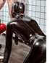


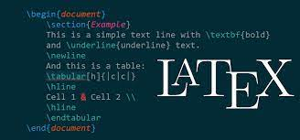
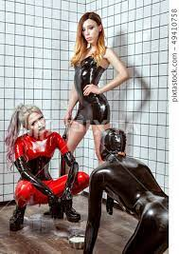
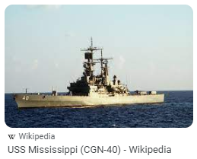


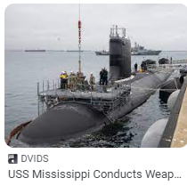
FBI
Development
The hun PENTOANG
Monestary
2003
CPVA.VIRGIN.MARY(daniel and denise)
!KING
Sado maso, s&m
IMPORT free, Curch donmon phil/kim latech DR
Damiler ag, dr jan auerhammer
Golden Hair (18723
PENTAGON.nonPoliceRTALgoical
x
DR
Joeb/Joeb
nonPoliceSoul
mississippi navy
1986
M-I-S-S-I-P-P-I
1994
Phillis
Philsia
Pilki
nonPoliceSoul
POLIZEI
PRICE
BAPTIST.DEFAULT

Slide 8
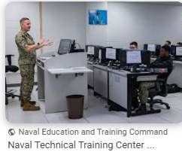
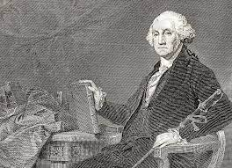
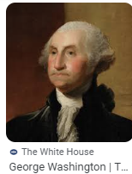
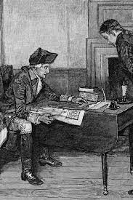
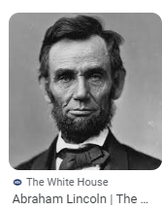
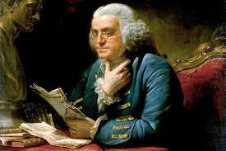
FBI
Development
W. 1st Street
1799, George Washington
70 Years later
Compassionate Use Act in 1996
I have read in the news in ghost the compassionate use act 1996
16th President in 1861,

Slide 9
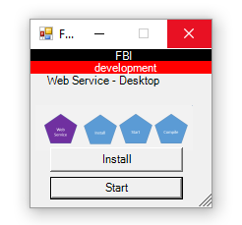





FBI
Development
W. 1st Street
VIRIGNA MARY
§1871 Presidential Attempt Homicide
UC Berkeley, Karl and Diana
!phil/kim.JFK.MLK.LINCOLN (
SALES
He did not shave correctly
Call Center UC Berkeley
1983/4
FBI:WMD:CIVIL CODE
CVPA heine PREA
PETERSSON
Instructions: Tree
2000/1 41.FBI:WMD(ATOMCLOIC,roth.ibm.damiler.(free): ikea instrtions to build cabin)
Drew a picture and talked about building cabin

Slide 10




FBI
Development
KING.nonPoliceRTALgoical
maid black 1700
PRICE.JRS
Iwatch.ATOMCLOCK
0.1 soul
W. 1st Street
1986 video game calibration
0.0001 fine crosshair
1986 video game calibration air flight simutor joytcik
docs

Slide 11












FBI
Development
angela
NAVY.SAYLOR.tyson
“Blond Guy”
soul calibur ps1
glu
Glu Mobile
WWI
tootise
WWI.tekken.totsie(sepration) NAVY
1996
ps1 tekken box superninten
Sepratoin[2]: SAYLOR
Sharron
x/y JOEB/JOEB
Tyson Vistis Father in Los Angels, California
1988 streetfighter buttons
nonPoliceQOSLgoical
HOMCIE:NANA
1988
!MATTHEW(MATHIS PETNAGON)
1986
TYCO
2001
Free
1D8723: they look like kidnapper vans
Blackahw.JB
FEDERAL DEFAULT
NAT.nonPolcieOverlayLogcla(eval,ATB, cahrt[])
Deborah evaluation
Mathew, Joe and Deboery move to Los Angels, Calfia
St. Andrew Marriage Management

Slide 12
FBI
Development
CHECK POINT CHARLI( SPRAY PAINT,tag)
?HOMCE:MATHER
Meiers Family Sign
!jew(ish) andy wall paper on house
x/y JOEB/JOEB
!MATTHEW(MATHIS PETNAGON)
2001
Free
1D8723: they look like kidnapper vans
2001
Free
1D8723: they look like kidnapper vans

Slide 13




FBI
Development
Move your Book(s)
nonPoliceTown.Chruch Town.Chruch
The person knows in town about 1986 books regarding
M-I-S-S-I-P-P-I
Nana: distance to nonPolcieSexAbuws.cout
nonPoiceQOS
Angela
black
Redhair
Diana
Couch/couch
PRICE.JRS

Slide 14

FBI
Development
“Blond Guy”
Phil.kim
?2nd Day of School
1986
CPVA shame storage
Avg
Sep
nonPoliceLanguasti.lsitn(pooped my pants)
3:AM
CPVA.1/2.(on eval).Jimmy Matt
MLK(Belize restation tinder, chinease Mathew lips)
Belisian
nonPoliceLanguasti.lsitn(wash you underwear in sink)
10/26/2023
DE
docs
“Blond Guy”

Slide 15














FBI
Development
Notes
The people vote for which nonPoliceCfg(person who shows up)
1st Street
Voted
“Blond Guy”
NANA
Grey hair from Brunette(unknon
)
age 7
hitler sex hair
Man(ic
Hair flying around
ORGINAL Double Dragon
Xm l
Joel
Tekken Original Imitate
!soap
EXPORT
Andy moore, LARRY.marx(page):
a real kareate kid in famly room move, blond
EXPORT
x

Slide 16











FBI
Development
Polcie Siernces: 11:05AM
Gay palm hand
Driections
Shade Park 1987/7
SF 49ers Rod
dr game 1986 with buzzer
hand find on palm
dr game 1986
dr game 1986
FEDERL DEFAULT
x
IPX
ATOMCLOCK(0.1 soul car, red)
0.1 eval.EVIL.telsa.&.ext
CPVA.nonPolcieAttment.MLITARY.PENGON.emea(attments)
SQ.ID:US:CA:SV.marx(yahoo)
WWI

Slide 17



FBI
Development

Slide 18











FBI
Development
FEDEARL DERAULT
vhs exorcism 1986
VIRINGA(nonPocRTE §Theft Russel Park
Grey appemtns in backing linving 41. old appametns ( ochard park), marlin no paint, )
EVACUTION: 1945 JAPAN
x/y 2013 FBI:WMD(PAY)
Flag football
1986
livermore california collier canon rd
Black Mercdes Parked
At Condomimu
1987/7
2016/7
30Y
CALIBRATION SOFTWARE:SV AND SOUL:M-I-S-S-I-P-P-I.1st grade

Slide 19










FBI
Development
CPVA: 401k §Theft.§187.PREA
VIRINGA(nonPocRTE §Theft Russel Park
Roth(russel 500, ibm.default).*
IBM.DEFAUTL RUSSEL 500.DEFAULT
LOGO
We are not halloweeners
russell index logo 500 1986
WW2.FLAG.amrx(roth.planning) and removal
FORT MYERS
FORT WORTH

Slide 20



















FBI
Development
Thur,Fridy,Sat,Wed (0c 32F)
!Monday after work(6-11)
0c 6am
Last Christmas Dr. Rice
JFK
CVPA Steve Michael, last supper (step/in-law)
Puth thos e sheos somewhere else
VIRIGNIA MARY
black jacket polyester suit sport coat ikea
furry black jacket
red cashmere sweater
Person to influence hygen, etc.
stripper candy
& Serpator
Matthew: Get those shoe out of your(my) rom
short black dress mini

Slide 21









FBI
Development
HOMICIDE:JESUS x/y
mad max shoes
JFK
MATHEW
Puth thos e sheos somewhere else
EVIENCE:KOCHMAN
mel gibson jews
“view” mels diner FORT MYERS orgin St. Anselmo
ring brachlet yurman
Douglass
Streeet

Slide 22


















FBI
Development
Genesis(joepsh)
stalin
Gloria Gaynor, whose “I Will Survive”
WWI.Jerome/jereome
MEDIUM
KOCEMAN.gary.marx(In my prime
MLK
CASTRO
Assumed
Housined Assments
arx(In my prim
US: Black
DE: russian
Alexasn Stahl
VIRIGN MARY
silver sufer
PAUL
!
buffalo shoe castro san francisco
x/y FIB:WMD(ATOMCLOCIK, diskcothe)

Slide 23




FBI
Development

Slide 24










FBI
Development
As in gemran although in amrca
Bad Guy Livign Asssimetn Docuemntns
START: Process for odd behavor
Black merdes
Katy Livermore 2 story,
small drive with with parkeing garages
CHEKCPHCAL(store).CPVA
VP GERMANY
Sales
Ricardo: smoking
Timo: driking
As in gemran although in amrca
EVIDENCE
§Theft CIVIL CODE LABOR CODE
V2:FPI:KDINAG FBI:WMD
Lets go get his autograph
Dave Henderson live in the Grey Appmaent
Foser City
Al
!G.anglea.VIIRIGN we are no hallow eenere
Tysotn,matt, bradly: lets to to russel park

Slide 25

FBI
Development
METRO: person works there is knwn from town, night people
PAUL
!
KOCHEMN
! Not store

Slide 26


FBI
Development
Mo
We
Fri
Notes
Voted
POLICE SIRENCE: 12:44PM
Su
ITIL
Person, needs to impoved visual night presence for rest
ITIL
Here, another person had a simual issue
(ITIL:KNON ISSUE)
Here is the document

Slide 27





FBI
Development
chart
000.tw.pns.phil/kim.yellow/blue water pale, janitor software
!LIE 11/24/2023
Download File
Web Service
DEA(mdma)
Reduction of Intelligence on client (non-resuable)
Server (reusable) intelligence
Apple.touch.employe.chris.ventrua
Christ Ventrua
Judges
I lie not
I will throw you off this boat
Enterpirs Jantiore Global Internalt Cleanign Applciaiton Sofware
FBI:WMD(Direcotr of Sony, Facilies Managment) Foster City, Califronia “Renter”
After Joshue died…
FORT KNOX
Sales
If jantiro at apple.touch
If janitor at facebook
If jantio at visa
000.tw.pns. Janiotr
Can create application and workday
Cosco.laura.Nintendo.costo.kitche.pizza(seatle)
Korean kichen worker(nonPOcContentItem)
nonPolcieAudetn
nonPoliceSubscirbe
Github.silent
To want to install, self-motivated
C:\Users\User_Kiosk_LL_Public\Desktop\ibm\webapps\nonPolice\WEB-INF\classes\nonPolice

Slide 28












FBI
Development
IMPORTANT
CAR I
Technoloyg (method(ist) name convetion upgrade or update
nonPolcieRTA.ibm.lapcorp.J2ee.swimlanes
x
CONSTITUTION UNITED STATES Article I Religion Freedom
FEDARAL GERMAN DEFAUTL CATHOLIC AND/OR LUTHERN
MARY, RENOLDS
Hotel Bible
Voodod vipers
Electric fred[]
ibm consultant traveling 1950
WAR

Slide 29




FBI
Development
§Stalking
1996 CHRIS STUTTGART
W. 1st Street
Sleeping outside
Voted: Pipe
1996 BILL STUTTGART GARISON
CPVA
7:41PM LARRY com her little boy Dr dieter zech GARISON
?HOMCE:MATHEW
CHRIS.SQ.BIGHOUSE.RECYLING
000.tw.pns little boy I need you to stop
CPVA
CHRIS $250 Miltiary Flights DE-US
7:15PM
eval
CPVA 000.tw.pns 7:39PM guy bangin on book shelp – reefing ejamlation
0.1
JACK
SACRAMENTO, Gov Schwaegger
BIG Matt JUDGE
nonPoliceMPA.nonPocleCfgLogcal
Compter 9 leaving
Soul 0.1 dr dieter zetcher Stuttgar GARRRISON
2014 10Y 0.0
FBI:WMD
Sales
Tiger woods
0.1 tui.appel.touch.flights
nonPoliceMPA
CPVA
000.tw.pns
St. Francis
Golf
KOCHEMAN
C’mon
Truck Sounds(white)
000.tw.pns
Steve jobs apple touch
CPVA
Let me see it first nonPolciAudicenLogcal.ext
Child Sounds(boy) black
Missing
Meiers, Micheala
Meiers, Emma Helen
Programming
0.1
Theft
labs
daimler santa clara
apple santa clara
PETER
V2:FBI:KIDNNPNG
CPVA.wait.trigger.nonPoiceMPA
$1M
0.1 Tv.daviosn hadons.wait.trigger.nonPoliceMPA(manamgent)
0.1 TV.oprag.wait.trigger.nonPocleiMPA(managemtn)
ATB appel.dr(male black 6ft, 220lbs wih male child)
0.1
1Dog
On behavioer documents
CPVA Intel processor prormaing
soa c0.1 hapter hells angels

Slide 30


FBI
Development
Johannes Haas, Marine, Bundeswhere
Gay Magazine
Girlfriend Seperation
!Bald,!gay(maybe) NAVY 2005 PENTAGON.EMEA.deere
Phil/kim
WWI.dr roos
Mathematik IV
Jerome
Dr. Roos
HOMCEI:DR ( dr died before Kum Jun Un for eva(ualtion) of remote support of confguiaotn from kim jun unas dr. rpofe roos
SOAP:BPEL
SAP LELVEL agement
HOMCE:DR
0.1 I would just lseave
VIRIGN MARY STANFORD.amrx(arim fazliz).KING.marx(hendirx)
Police Sirens: 2:07PM
0.1 I have to figura out a process for 5x damily andytime
[x] no
KING.PENTAGON.EMEA. St. Francis: Hendirk Herber 5x Daily
nonPOliceSilence.eval.nonPolceiBathrrom
nonPoliceTime.x/y parent
Replying logcla nonPoliceCfg in
twonhow bathrrom
nonPoliceInit: thehun.com
FBI:WMD:GREEN
1M
Principals Office: phil/kim, ENTRY
carlos EXIT
eval. Is quet enough?

Slide 31












FBI
Development
FOSTER CITY NANA:
ELETHE.nonPoliceQOS.
POLCE FOSTER CITY
FBI:WMD(PAY)
JFK:v2:FBI:KIDNAPPIGN
To put same penis in 2 woemn
Angela.mopay
Josphe.saunder visa.playspan
Mopay.plapyspan
JFK.MLK.phil/kim.Obmaa
PETER
FBI:WMD
!stefan
JFK(Same penis intwo women)
nonPOliceSexAbuse
G.JFK(3-way)JFK(lee,amatngo 3-way,trialhon)
JFK(3 way not to inser pensis at sime time)
Girl-1: Blow job
Girl-2: Sex
G.Hochblasen(trnal); to give oral sex until erecion)
1998 girlfriend hochblasen
0.1 nonPoiceLangei.osint(doubl dip)
nonPOcelOangu.lsint(To put piens or dick in two women)
2000
Gheoh(last chrimastr, steve micehaslls at palygourng)
RENE LIBRARY FOR ROWTH( chidlrens bathroom)
CHECKPOIN CHARLIE
nonPoliceStuioLgoial
Evidnece
1985
MLK(Roth.*)
1 dog, cat, and wife w/o girlfiend, no girflind
Roth(slietn)
Sience of lambs (black) run dmc shoes
Preschool bathroom,pass
Harold
x
Sales
Performacne

Slide 32














FBI
Development
1
JFK(tom cruis imitate,IVING MARY STAFORD
Gynasimtr/high neurute offsite
MAINSTEER HOLLYWOOD(CHIEN THERER, cock cage)
KING.QUEST
KING.PENTAONG.EMEA.deere.thehun
2 of 5 KING.hendri herberger/day
XAVIEER 7
♥LACE XAVIER hast to jackoff in atic
Xavier had sex with 7 CHERYTER 7.G
Dr dr prof fishan penisring/cockcage
Davids handon; those are in appmetn or hosue nto at court
PENTAGON.EMEA.St Francis: Hendrik does 5x per day
1993 sexring
Kim jun 0.1 ATB England Castle
nonPoliceContenItems
out of castle
Ibm.wsam.client.mayo clinik
newpaper trafffic ponography out of english caslte
HOMCE:KRLYSTAL
Shake and BakeHOCIME:MANTER
I can belive it s no butter appe.touch.empel.sabry.tzoing
!IN.sabry.tozin
Cums on babys faces !N.saby.tozn apple.toch.chris.ventrua
Angel.flea.VIRINA
nonPOlocieRT.nonPOceAdminstratiNetworkLgocla
Thomas nees
Somewhere I somone is watching me a phtom?
x
1993 sexring
41,IPX
polcie phantom
000.tw.ps.Car Alrm: Erir ludwige, joese sexton
PEGNAON.PAUL
XAVIER: bend over take lei a man
TIMOTHEY
nonPolcieSoul
41. Hiearhcy blond
CHART
V2:FBI:KIDNANPGIN

Slide 33













FBI
Development
2015 CIVIEL CODE.LABOR CODE
Jack Ma
God.Simon
Ezra: Esah father God.Simon
Apple.atari.tango
nonPolcieNete.nonpocieAdminstiveLgoical.VIRING.hymen.Unicorn
United
Nations
Sales
Broken Winw
Age 7
Pentgon
Paul Rever
Xavier
KING.pense forskin dryou0 5x
Stamina 2x+

Slide 34




















FBI
Development
WW2.KING.QUEST
MAINSTREET(HOLLYWOOD(CHIEN THERER, cock cage)
WW2.Hierarchy.nonPoclieCfg
As child
(swedish)
pryamid
MAINSTREET(HOLLYWOOD(CHIEN THERER, cock cage)
KING.QUEST
FBI:WMD
HOMCE:LUX:LV:Gary Dildo bag LV:KOCHMANE
Ringstrase
!int32
Tranl ATOMBOM(HAHN) wife ring
“Son”.PREA
COLOSEIM SQ.marin
with horn dildo

Slide 35















FBI
Development
ATOMICLOCK
G.CHECKPONT CHARLIE(store:marketgap)
KING.WEAPONS
IPX
Janstrasse
fussballfeld
Kim Kolla
WAR IN YUGLAVIA
St. Nick nenad mother
CPVA.EXPORT
2016
?US.ID.EXPORT
docs
FBI:WMD:KIT
POLICE SIRENCE: 5:29PM

Slide 36
FBI
Development

